Slide 1




Alpha Analysts
Jenny
Michelle
Scott
Thapa
Project engineer
Strategy consultant
Quality assurance manager
Project manager

Slide 2
Project Summary
Determine BUY-SELL signals for top performing US stocks using
MACD indicators and Time Series analysis
ML
Regression
Time
Series
ML
Classification
Buy-Sell
Signal

Slide 3
Project workflow
Date
Open
Low
High
Close
Adj Vol
Vol
2019-12-31
1842.0
1853.3
1832.22
1847.84
1847.39
2506500
2020-01-07
1904.5
1913.9
1892.04
1906.85
1906.85
4044900
2020-01-07
1904.5
1913.9
1892.04
1906.85
1906.85
4044900

Slide 4
Project workflow
Autocorrelation (ACF)
Partial autocorrelation (PACF)
Date
Close
2019-12-31
1847.84
2020-01-07
1906.85
2020-08-01
1906.85
AIC
BIC
2, 1, 1
4630.36
4650.57
1, 1, 2
4630.36
4650.57
1, 1, 3
4630.36
4650.57

Slide 5
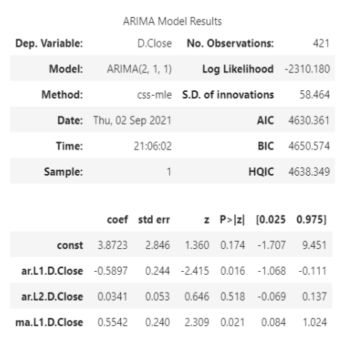
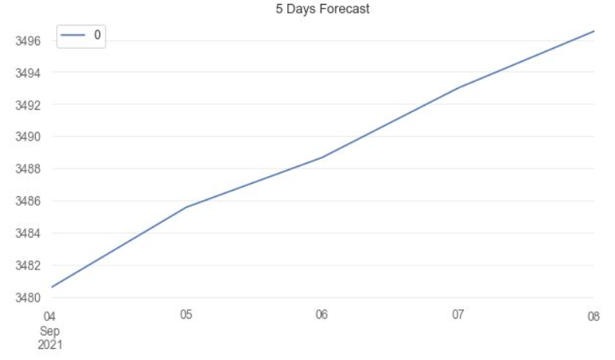
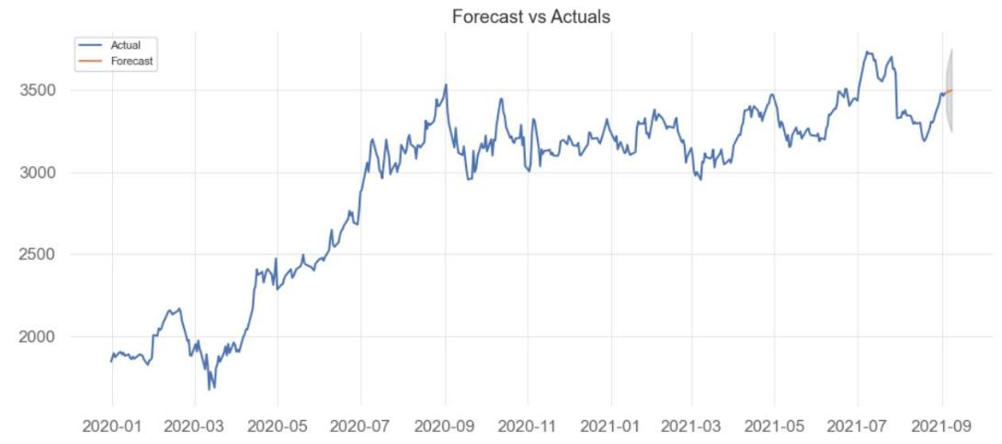
Times Series Analysis
Predicting 5days Amazon’s stock movement
Result
P value indicates good fit. However, still have room for improvement

Slide 6
Final data frame
Date
Close
2019-12-31
1847.84
Actual Close prices
2020-01-07
1906.85
2020-08-01
1906.85
Date
Close
Day 1
1847.84
Day 2
1906.85
Predicted Close prices
Write your paragraph here
Summary
Day 3
1906.85
Write your paragraph here
Day 4
1906.85
Day 5
1906.85

Slide 7
Machine Learning - Regression Models
 | Linear Regression | Random Forest | Extra Trees | Lasso Regression | Ridge Regression | Stochastic Gradient Design
Mean Squared Error | 0.245339 | 0.246907 | 0.247462 | 0.250000 | 0.245328 | 0.244234
Root Mean Squared Error | 0.495317 | 0.496897 | 0.497456 | 0.500000 | 0.495306 | 0.494201
R2 | -0.349802 | -0.358429 | -0.361484 | -0.375446 | -0.349742 | -0.343724
R square: Negative value
Models do not follow the
trend of the data
Fits worse than a horizontal line

Slide 8
Machine Learning - Classifications
 | Logistic Regression | Random Forest | Gradient Boosting | Ada Boost | XGB
precision | 0.646031 | 0.646031 | 0.646031 | 0.646031 | 0.646031
recall | 0.647059 | 0.647059 | 0.647059 | 0.647059 | 0.647059
f1-score | 0.646315 | 0.646315 | 0.646315 | 0.646315 | 0.646315
support | 425.000000 | 425.000000 | 425.000000 | 425.000000 | 425.000000
mse | 0.352941 | 0.352941 | 0.352941 | 0.352941 | 0.352941
rmse | 0.594089 | 0.594089 | 0.594089 | 0.594089 | 0.594089
~65% accuracy for predictions
Low precision & recall score

Slide 9
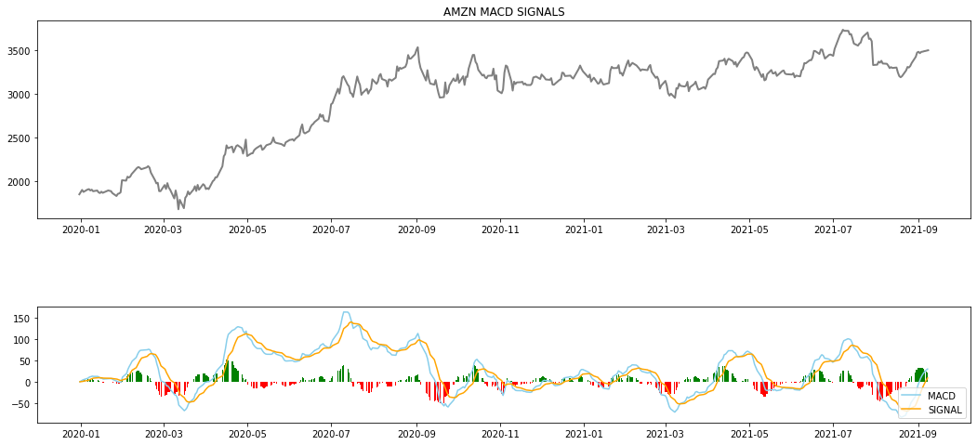
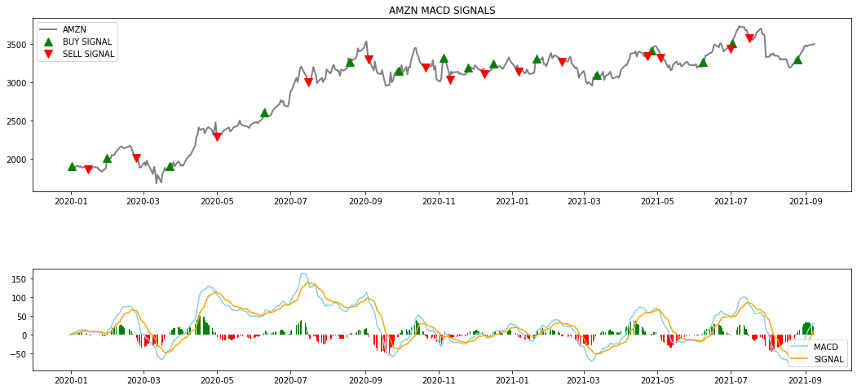
MACD Indicators
MACD = [12-Period EMA] – [26-Period EMA]
Signal line = 9-Period EMA
MACD crosses ABOVE signal line – BUY
MACD crosses BELOW signal line -SELLL

Slide 10
MACD backtesing
Given $100,000 initial investment
Using only MACD indicators
Backtesting on
AMZN trading
Trying on
different stock
Result vary
Result
Exercising MACD signal creates 12 times profit to just holding
Backtesting on
diversified portfolio
Result
Just holding double the profit of exercising MACD strategy

Slide 11
Conclusion
MACD prices are good indicators to generate BUY-SELL signals
However, other metrics such as Relative Strength Indicator (RSI) and Fibonacci indicators should also be used to make an informed decision to trigger a BUY or SELL

Slide 12
Sources
Google Colab
ScikitLearn
Matplotlib
Pandas
Yfinance
Vectorbt
Quantstats

Slide 13
Any Questions…

